Slide 1
Martha and Mary

Slide 2
Opening Prayer
Patient God, give us ears to hear, time to be still, courage to stop what we are doing and a willingness to listen to your words. Amen.

Slide 3
I confess to almighty God and to you, my brothers and sisters, that I have greatly sinned in my thoughts and in my words, in what I have done, and in what I have failed to do; through my fault, through my fault, through my most grievous fault; therefore I ask blessed Mary ever-Virgin, all the Angels and Saints, and you, my brothers and sisters, to pray for me to the Lord our God.

Slide 4
Halle, Halle, Halleluijah

Slide 5
The Gospel
Reader: A reading from the Holy Gospel according to Luke 10 38-42
All: Glory to you, O Lord
Reader: The Gospel of the Lord
All: Praise to you, Lord, Jesus Christ.

Slide 6
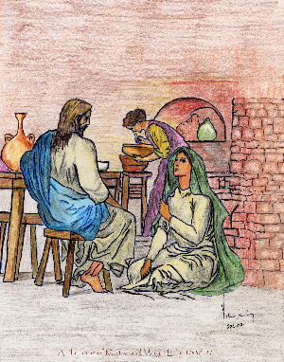
Martha has a sister called Mary who is pleased to see Jesus and immediately sits down to hear him speak. Martha is busy with tasks.

Slide 7
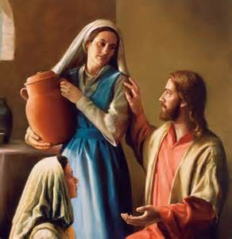
Why is Martha cross with Mary and what does she say to Jesus? How does Jesus reply to Martha?

Slide 8
What does this story teach you about listening? And to whom

Slide 9
When should we be busy and when should we be quiet? Both are important in our lives but we need to get the balance right.

Slide 11
Intercessions
Lord hear us..
Lord graciously hear us

Slide 12
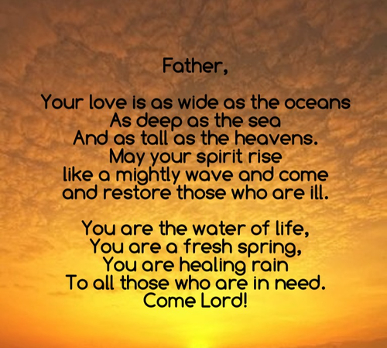

Slide 13
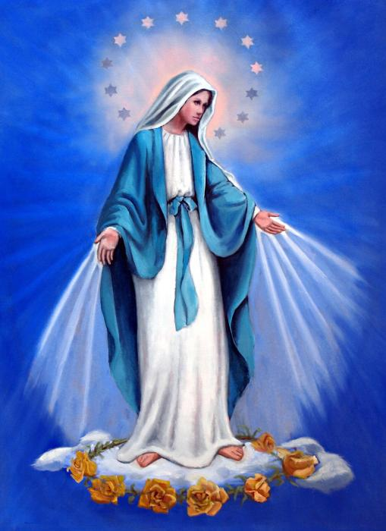
Hail Mary, full of grace…

Slide 14
Seek ye first the Kingdom of God,
And his righteousness,
And all these things shall be added unto you
alleluia, alleluia.

Slide 15
Alleluia, alleluia, alleluia, allelu, alleluia.

Slide 16
Ask and it shall be given unto you,
Seek and ye shall find.
Knock, and it shall be opened unto you,
Allelu, alleluia.

Slide 17
Alleluia, alleluia, alleluia, allelu, alleluia.

Slide 18
Closing Prayer
Christ our still centre, in this silence be with us in mind and body. Like Mary, let us turn to you with open hands and ready hearts, always being prepared to listen to your voice. Amen.

