Slide 1
St David

Slide 2
St David is Patron Saint of Wales
This is the flag of St David

Slide 3
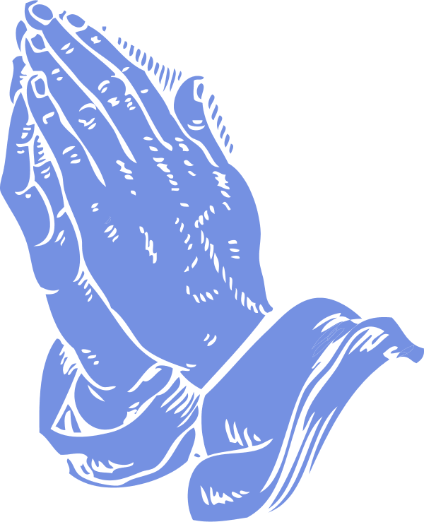
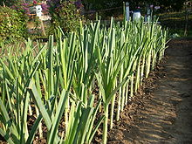
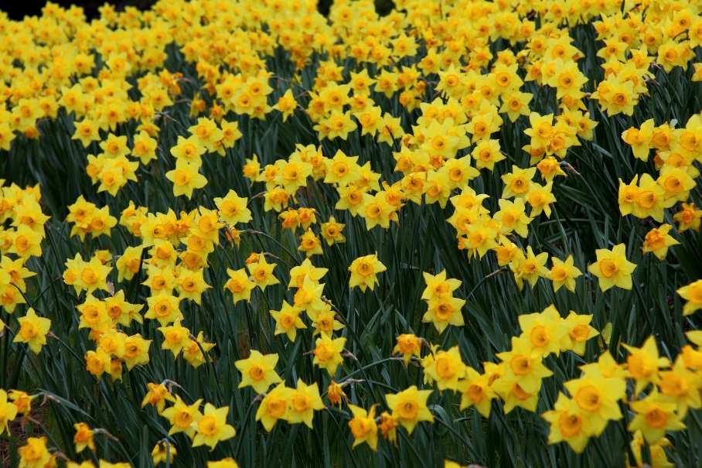
Signs & Symbols

Slide 4
We celebrate St David’s day on March 1st.

Slide 5
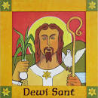
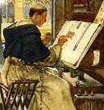
St David loved to listen to monks spreading the word of Jesus.
His mum and dad knew he was special because a white dove followed him everywhere he went.

Slide 6
St David become a monk when he was older.
One day he saw that his teacher was not well as he was blind. He wanted to help his teacher. He touched his eyes and then when he opened them his teacher could see!
St David performed a miracle!

Slide 7
One day, Something wonderful! happened! When the people went to hear David preach they could not see him. Suddenly, when David started to preach, the ground rose to make a little hill! Everyone could now see and hear David!

